Slide 1



QUITQ
Ecommerce Application
By Bhagya B

Slide 2
PROBLEM STATEMENT
To design and develop a fullstack E-Commerce application called "QuitQ". QuitQ is a comprehensive application designed to facilitate e-commerce transactions between buyers and sellers. This system encompasses the entire shopping process, from product browsing and selection to payment processing and order fulfillment. It aims to provide a seamless and secure shopping experience for customers while enabling efficient management for sellers.
Scope:
User Registration and Authentication
Product Catalog
Shopping Cart
Order Processing
Inventory Management
Seller/Admin Dashboard

Slide 3













TECH STACK
React 18
HTML5
CSS3
JavaScript
C# 12
ASP .NET
Web API
ASP .NET
Core MVC
SQL Server
JWT Tokens
EF Core
NUnit
Moq
Git

Slide 4
DATABASE
Users
Sellers
Wishlist
Offers
Payments
Orders
Addresses
ShoppingCart
OrderItems
ProductReviews
Products
Categories
Brands

Slide 5
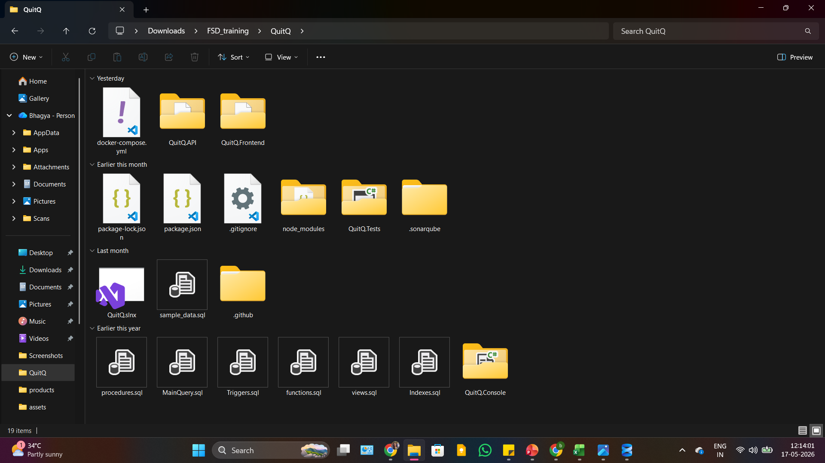
PROJECT STRUCTURE

Slide 6
APPLICATION FLOW
React
Frontend
ASP .NET
Web API
SQL
Server
Axios
API Calls
Controllers
Interface
Services
EF Core
(DbContext)

Slide 7
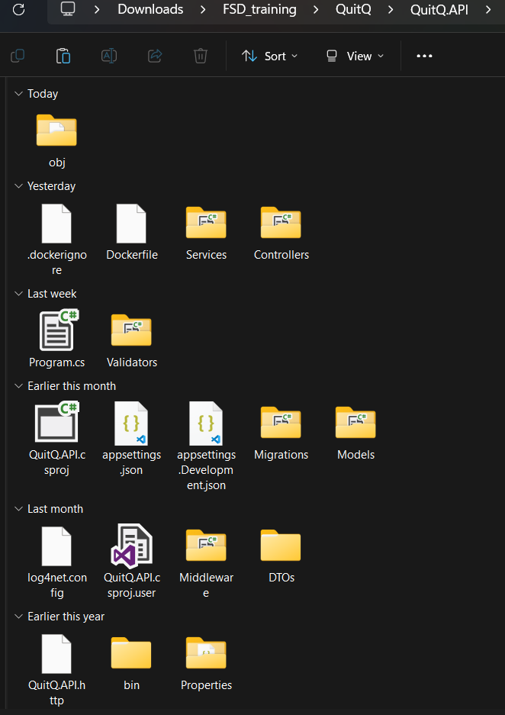
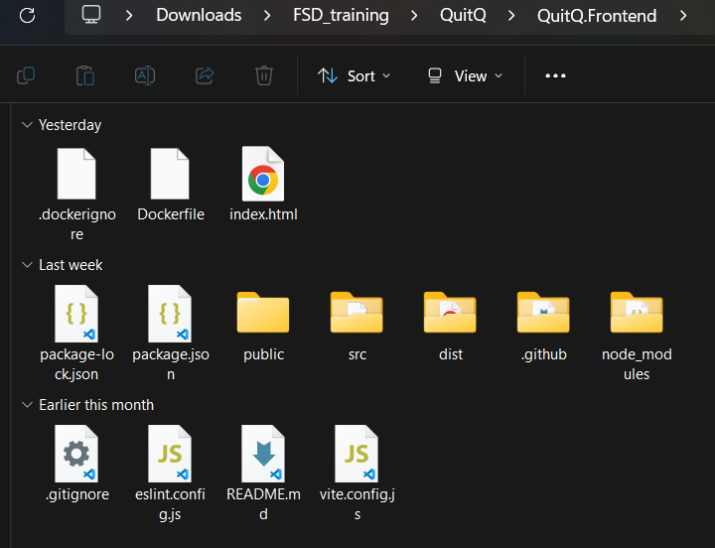
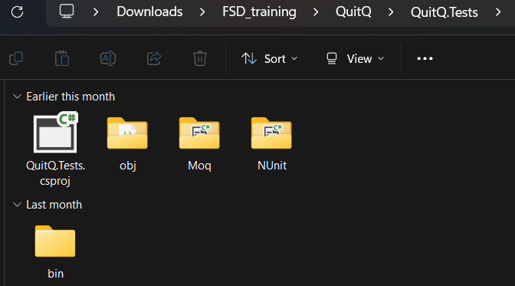
PROJECT STRUCTURE

Slide 8
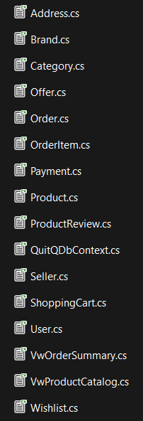
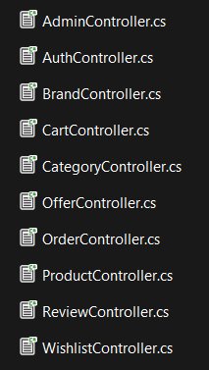
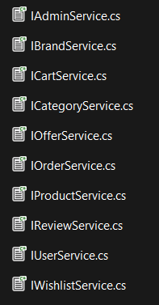
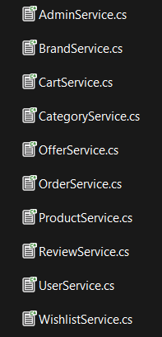
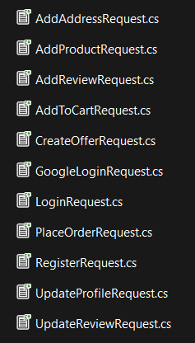
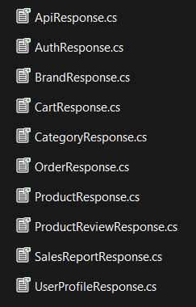
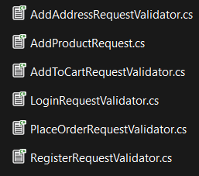

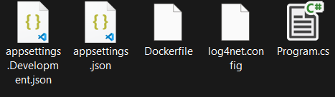

BACKEND

Slide 9
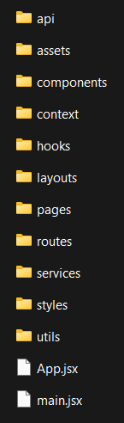

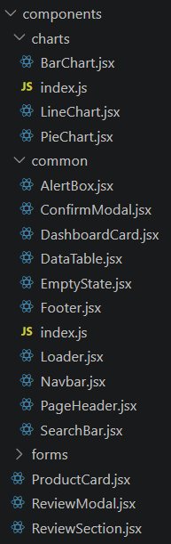
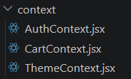
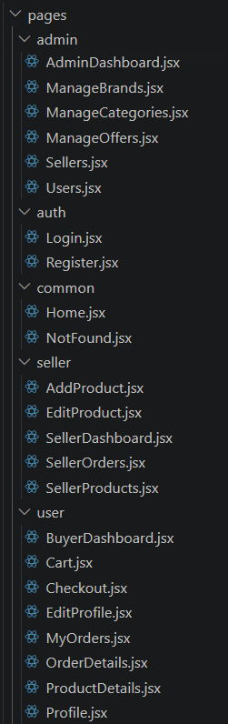
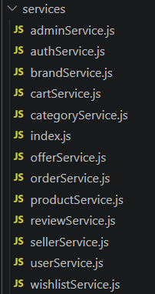
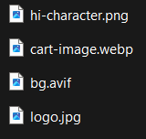
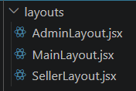
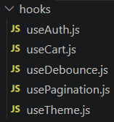
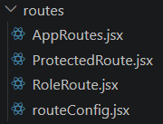
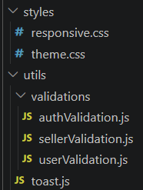
FRONTEND

Slide 10
DEMO IMPLEMENTATION,
CODING & TESTING

Slide 11
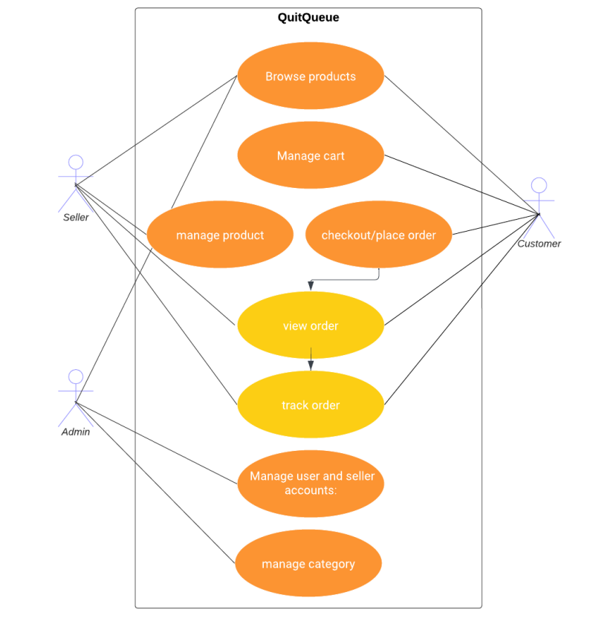
✅
✅
✅
✅
✅
✅
✅
✅

Slide 12
SOLID PRINCIPLES
Single Responsibility Principle - One class, One responsibility.
Open/Closed Principle - Open for extension, Closed for modification.
Liskov Substitution Principle – Classes are replaceable without breaking functionality.
Interface Segregation Principle – Clients should not depend on methods they don’t use.
Dependency Inversion Principle – High level modules shouldn’t depend on implementations.

Slide 13
DESIGN PATTERNS
Service Layer Pattern
Dependency Injection Pattern
Chain of Responsibility (Middleware Pipeline)

Slide 14
BEST PRACTICES
Layered Architecture & Seperation of Concerns
Logging using Log4net Concepts
Sonarqube for Code Analysis
Usage of DTOs
Validation
Async Programming
Git & Version Control
Reusable React Components

Slide 15
THANK YOU
Thank you to the entire Hexaware team for providing valuable training, guidance, and industry-oriented learning throughout this Full Stack Development program.
Special Thanks To Ms. Jyoti Patil for her continuous support, mentorship, technical guidance, and encouragement during the development of this project.

